Slide 1
STRINGS

Slide 2
Fundamentals of characters
Characters
  Building blocks of programs
    Every program is a sequence of meaningfully grouped characters
  Character constant
    An int value represented as a character in single quotes.
    Eg: char a= ‘6’;

Slide 3
Fundamentals of strings
Strings
  Array of characters treated as a single unit called string:
    Can include letters, digits and special characters (*, /, $)
  String literal (string constant) - written in double quotes
    “Lovely Professional University."

Slide 4
Fundamentals of strings
Strings are arrays of characters
  String is a pointer to first character
  Name of string is the address of first character
Each element of the string is stored in a contiguous memory locations.
Terminated by a null character(‘\0’) which is automatically inserted by the compiler to indicate the end of string.

Slide 5
String Definition
They are defined as
char array_name[size];
e.g. char carname[30];
It defines an array name and reserves 30 bytes for storing characters and single character consumes 1 bytes each.
Since the last byte is used for storing null character so total number of character specified by the user cannot exceed 29.

Slide 6
String Initialization
Initialization
  char m[9] = “I like C”;
  char m[ ] = “I like C”;
  char m[ ] = { ‘I’, ‘ ’, ‘l’, ‘i’, ‘k’, ‘e’, ‘ ’,’C’ };
  char m[ ] ={ { ‘I’ },{ ‘l’ },{ ‘i’ },{ ‘k’ },{ ‘e’ },{‘u’ } };

Slide 7
The empty brackets notation [ ] tells the compiler to calculate the size of the array automatically. This is in fact the same as allocating it explicitly, adding one to the length of the string:
char name[ ] = "John Smith"; OR
char name[11] = "John Smith";
The reason that we need to add one, although the string John Smith is exactly 10 characters long, is for the string termination, a special character (equal to \0) which indicates the end of the string.

Slide 8
String Input/Output
The scanf() function only takes the first entered word. The function terminates when it encounters a white space.
Inputting strings scanf.
      scanf("%s", word);
    Do not need &
    It happens because array name is nothing but a pointer pointing to the first location in array.
    So the name of the string is itself the address of string. When you write the name of an array , it implies its base address.
Displaying strings
  Use printf. printf("%s", word);

Slide 9
Program to read and display string
#include <stdio.h>
void main()
{
char carname[20]; //string char array
printf(“Enter the name of your car: ");
scanf("%s", carname);
// to display the input
printf(“\nName of car is %s", carname);
} //end main
Enter the name of your car: XUV500
Name of car is XUV500
Output

Slide 10

How?
The last program will print only a single word not the sentences with white spaces?
That is if input is
Lovely Professional University
Output will be:
  Lovely
So how to print:
Lovely Professional University
use gets and puts

Slide 11
Standard I/O Library Functions
To do anything else with strings, we must typically call functions. The C library contains a few basic string manipulation functions, and to learn more about strings, we'll be looking at how these functions might be implemented.
List of functions in #include<stdio.h>
Used for string input/output functions.
Function | Description
gets( char *s ); | Inputs characters from the standard input into the array s until a newline or end-of-file character is encountered. A terminating null character is appended to the array.
puts( const char *s ); | Prints the string s followed by a newline character.

Slide 12
Standard I/O Library Functions
To make life easier, there are predefined functions gets() and puts() in C language to read and display string respectively.

Slide 13
Program to print strings with white spaces using library functions
#include <stdio.h>
void main()
{
char name[100]; //string char array
puts(“\nEnter a string: ”);
gets(name); //to input string with space
printf(“\nString is: ”)
puts(name); //to output const string
}//end main
Enter a string:
Lovely Professional University
String is:
Lovely Professional University
Output

Slide 14
Program to print strings character by character using loop.
#include <stdio.h>
void main()
{
char name[]={“Lovely Professional University"}; //string char array
int i=0;
while(name[i]!='\0') //untill null character
{
printf("%c", name[i]);
i++;
}//end while
}//end main
Lovely Professional University
Output

Slide 15
String Handling Library
Functions defined in #include<string.h>
String handling library provides many useful functions:
  Manipulate string data(copy and concatenate)
  Comparing strings
  Determine string length
  Search strings

Slide 16
String Manipulation Functions
List of string manipulation functions
Function | Work
strlen() | Calculates the length of string
strcpy() | Copies a string to another string
strcat() | Concatenates(joins) two strings
strcmp() | Compares two string
strlwr() | Converts string to lowercase
strupr() | Converts string to uppercase

Slide 17
Determining the length of string
strlen()
Function strlen in #include<string.h>
Function strlen() takes a string as an argument and returns the number of characters in the string
  the terminating null character is not included in the length
Syntax of strlen()
strlen(string_name);

Slide 18
Program demonstrates string length function strlen()
#include <stdio.h>
#include <string.h>
int main()
{
char a[20]="Program";
Char b[20]={'P','r','o','g','r','a','m','\0'};
char c[20];
printf("Enter string: ");
gets(c);
printf("Length of string a=%d \n",strlen(a));
//calculates the length of string before null charcter.
printf("Length of string b=%d \n",strlen(b));
printf("Length of string c=%d \n",strlen(c));
return 0;
}

Slide 19
Enter string: String
Length of string a=7
Length of string b=7
Length of string c=6

Slide 20
strcpy() and strncpy()
strcpy() copies the entire second argument string into first argument.
  strcpy( s1, s2);
strncpy() copies the first n characters of second string argument into first string argument.
  strncpy( s1, s2, 4);
  The third argument is less than the string length of the second argument.

Slide 21
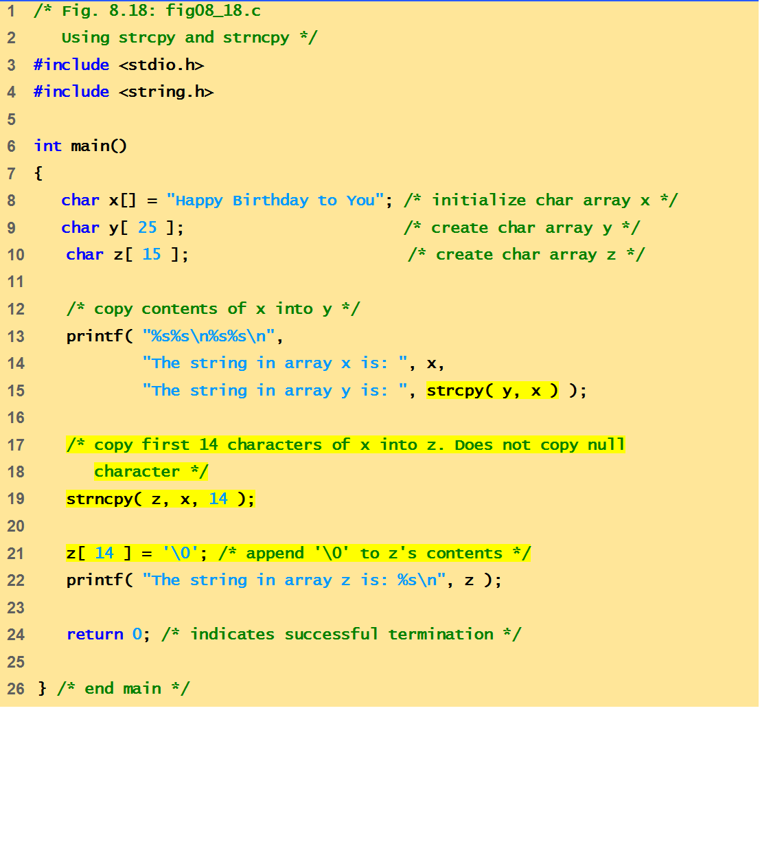
This program demonstrates string manipulation/ processing functions: strcpy() and strncpy()

Slide 22
Output
The string in array x is: Happy Birthday to You
The string in array y is: Happy Birthday to You
The string in array z is: Happy Birthday

Slide 23

strcat()
Function strcat appends its second argument string to its first argument string.
strcat( s1, s2);
The array used to store the first string should be large enough to store
  the first string
  the second string and
  the terminating null character copied from the second string.
Quick yak:
Ask the students to work with f_name, l_name arrays of their names using
Strcat()

Slide 24
strncat()
Function strncat appends a specified number of characters from the second string to the first string.
strncat( s1, s2, 6)
A terminating null character is automatically appended to the result.

Slide 25
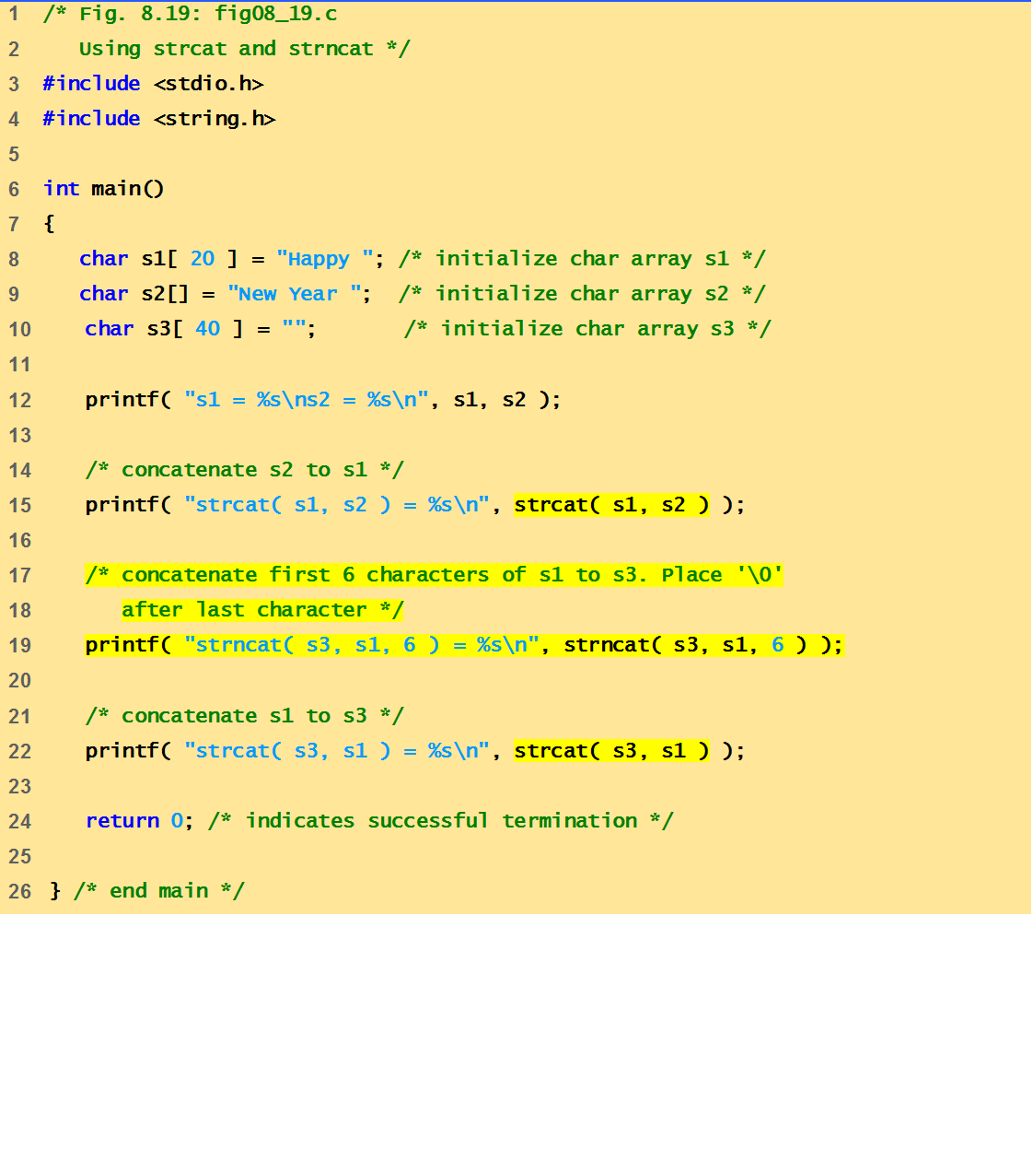
This program demonstrates string manipulation
functions: strcat() and strncat()

Slide 26
output
s1 = Happy
s2 = New Year
strcat( s1, s2 ) = Happy New Year
strncat( s3, s1, 6 ) = Happy
strcat( s3, s1 ) = Happy Happy New Year
Quick yak:
Ask students to print their names as:
Ankur Sharma
Sharma Ankur
Ankur S.
A. Sharma

Slide 27
Comparison Functions of the String Handling Library
Comparing strings
  Computer compares numeric ASCII codes of characters in string
  strcmp() Compares its first string argument with its second string argument, character by character.
  Function strncmp() does not compare characters following a null character in a string.

Slide 28
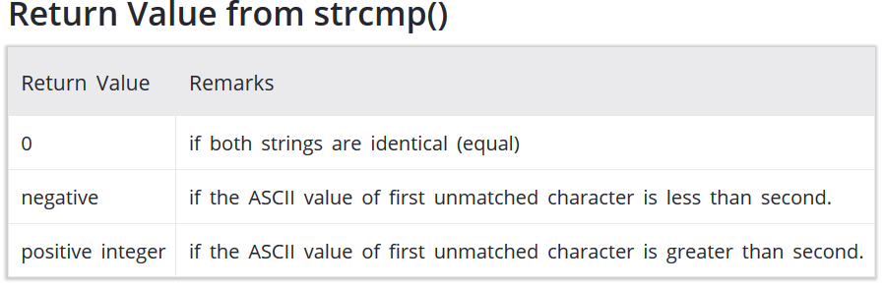
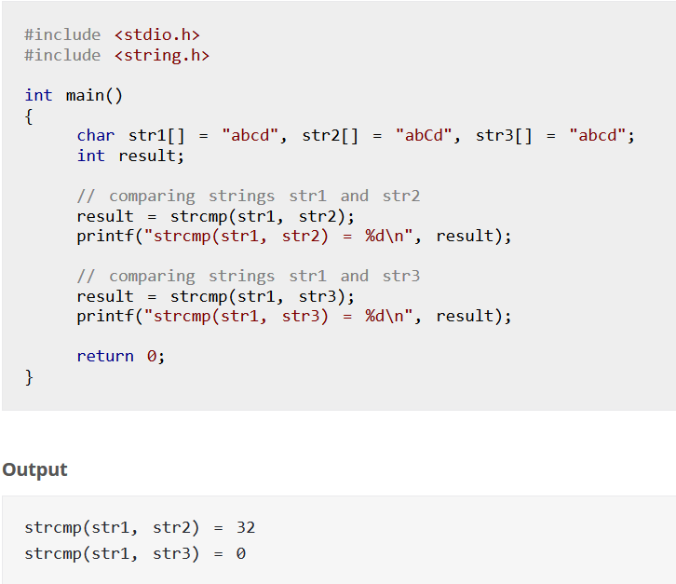
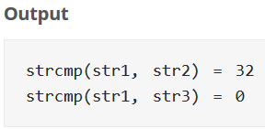
1

Slide 29
More String Library Functions
strlwr() function converts all the uppercase characters in that string to lowercase characters.
strupr() function converts all the lowercase characters in that string to uppercase characters.
strrev() function reverses a given string in C language.
strset() function sets all the characters in a string to given character.
strnset() function sets n number characters in a string to given character.

Slide 30
Example of strlwr() strupr()
#include <stdio.h>
#include <string.h>
int main()
{
  char str1[]="LOWer Case";
  puts(strlwr(str1));
  //converts to lowercase and displays it.
  return 0;
}
#include <stdio.h>
#include <string.h>
int main()
{
char str1[]="UppEr Case";
puts(strupr(str1));
//Converts to uppercase and displays it.
return 0;
}
Output:
lower case
Output:
UPPER CASE

Slide 31
Next Lecture
Mining different types of data from string …??
String conversion functions

